Slide 1

Transition Implementation
Strategic Plan 2026-2030

Slide 2
Purpose of the Presentation
3- Month Transition Period Overview
Preview the Finalized Strategic Plan Document 2026- 2030
Review Workplan & Administrative Task Alignment
Final Transition & Next Steps
Notes:
Motion 2 directed Leadership to provide guidance and structure throughout the implementation process.
Today, we will provide an overview of the key actions completed, progress made, and the final steps as we close out the implementation plan.
Implementation Timeline Completed a three-month implementation period focused on restructuring the subcommittee and carrying out the approved changes.
Strategic Plan Updates Present a preview of the finalized Strategic Plan document.
Review the workplan and administrative alignment, as requested by the subcommittee.
To conduct a crosswalk to demonstrate how the goals, objectives, and administrative responsibilities align with the Strategic Plan.
Transition & Next Steps Introduce new processes developed to support the final transition period.
Highlight how these processes will strengthen implementation and support a smooth, sustainable rollout.

Slide 3
Progress Towards ECAC Restructure
Restructure of the Subcommittees
Appointed Co- Chairs for each Subcommittee
Launched 2 New Subcommittees
Updated our Meeting Schedule
Provided Onboarding and Trainings for Co-Chairs /Secretaries
Developed Workplans that Aligns with 2026-2030 Strategic Plan
Notes:
Transition Progress
This slide highlights the key milestones achieved during our three-month transition period.
Successfully restructured the subcommittees, allowing members to transition into committees that best align with their interests and expertise.
Appointed new subcommittee chairs, with one Co-Chair position still to be filled for the Family Engagement Subcommittee.
Launched the two new subcommittees, updated the meeting schedule, and added a standing agenda item to allow meeting rescheduling while avoiding scheduling conflicts.
Provided training for secretaries and new Co-Chairs to support their roles.
Completed workplans aligned with the Strategic Plan goals.
Closing: With the transition complete, we are now positioned to focus on implementing our priorities and advancing the work ahead.

Slide 4
ECAC Guidance
Completed Strategic Plan Documents
Development of Subcommittee Guidance
Aligning Bylaws to the Strategic Plan
Revised NDE Posting Protocol
Notes:
Updated the Strategic Plan with all recommended revisions and finalized the design. Developed a Subcommittee Guidance document to provide structure and support alongside the bylaws. Revised the bylaws to align with the new Strategic Plan and subcommittee structure. Implemented updated NDE meeting protocols, including new agenda formatting and a five-day posting requirement, with additional changes anticipated.

Slide 5
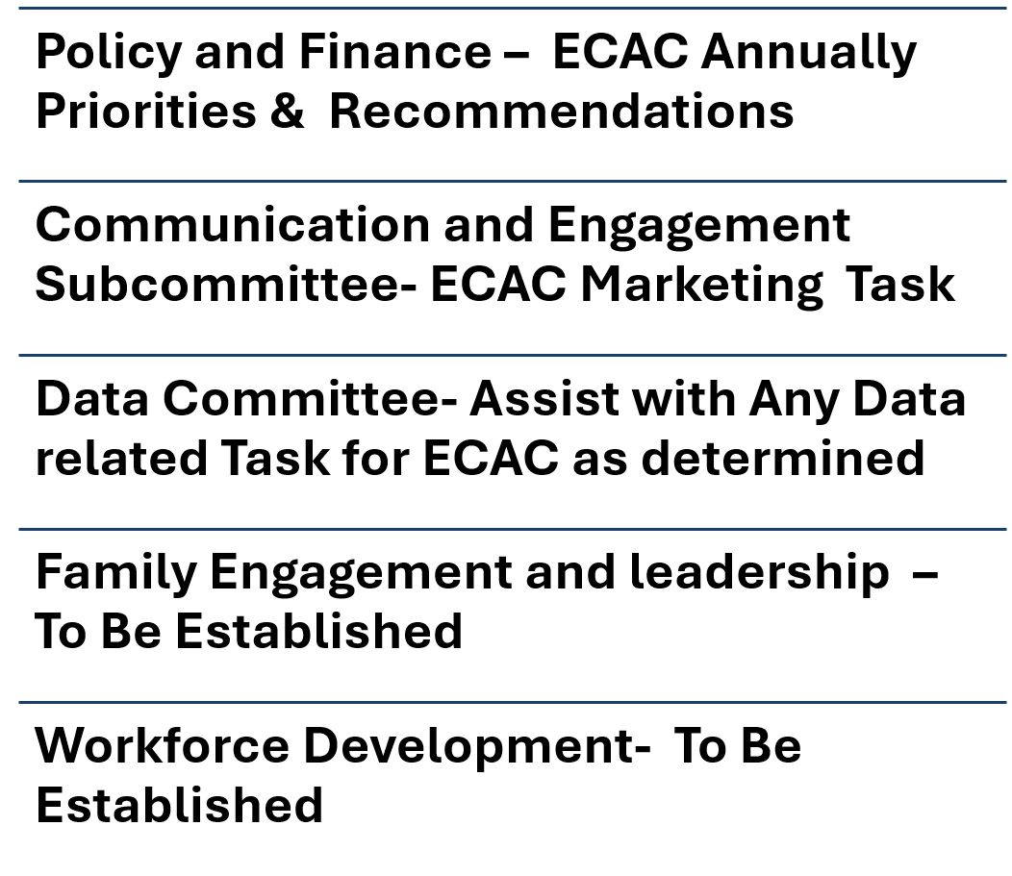
Alignment of Administrative Task
Notes:
Administrative Alignment
Policy & Finance: Continue leading the ECAC Annua priorities and recommendations, with input from all subcommittees to support the development of the annual report and recommendations to our Governor.
Communication & Engagement: Support website updates, social media, publications, and ECAC events.
Data: Provide data support and analysis that aligns with the Strategic Plan priorities when of if needed
Family Engagement (Proposed): Coordinate family presentations, annual family panels, and provide family feedback opportunities.
Workforce Development (Proposed): Strengthen collaboration with local ECACs and support workforce development initiatives. Once you are well established.

Slide 6

Sneak Peek of ECAC Strategic Plan 2026- 2030
Notes:
It time for a sneak peek of our strategic Plan, or we can provide a copy if we don’t have time to review.

Slide 7
Subcommittee Tools and Resources
Agenda Request form
Subcommittee Alignment
Notes:
Next, we will review: Subcommittee alignment
Agenda request process.
New forms developed to support each task
These tools were created to provide consistency and support a smooth transition

Slide 8

Subcommittee Alignment
PURPOSE
To identify collaboration opportunities by reviewing the subcommittees involved with each Goal and Objective, creating a space for Co-Chairs to discuss
Collaborate on activities and projects that both Subcommittees have an interest in
USES FOR:
SUBCOMMITTEES
ADMINISTRATORS
COLLABORATING
Notes:
Brandi
https://docs.google.com/spreadsheets/d/1gAF4ApLMMY_k2N6TJsMKNI1QB7b2Wq9Q2t_I2Y9cVu8/edit?usp=sharing
SUBCOMMITTEES CAN SEE WHAT PTHERS ARE WORKING ON
ADMIN CAN SEE BRIEF OVERVIEW OF KEY ACTIVITIES IN ONE PLACE
IF AN ATIVY WOULD WORK WELL WITH COLLABORATING PARTNERS, YOU CAN IDENEITFY WHO BEST TO CONTACT
To identify collaboration opportunities by reviewing the subcommittees involved with each Goal and Objective, creating a space for Co-Chairs to discuss and collaborate on activities and projects that both Subcommittees have an interest in

Slide 9
AGENDA ITEM REQUEST FORM
Streamline the way you add items to your agenda!
Subcommittees can now do the following:
Title and overall topic description
Request ScreenShare Assistance( as needed)
Upload documents that go along with the agenda item
Share links that go with agenda item
Name the Presenters (if not the Co-Chairs)
ask for a specific (amount of time)
STEPS TO REQUEST ITEMS:
Secretary
completes form
Secretary
Submits Minutes & Form 1 week after meeting
SECRETARY AND CO-CHAIRS
discuss what to add to agenda
*NO REVISIONS
TO POSTED AGENDAS*
Notes:
Brandi
Secretary Responsibility:
Completing the Following Steps:
Collaborate with co-chairs
Complete & Submit online form - Standing items not necessary
Email Minutes, noting the Form is
submitted
Co-Chair Responsibility:
Be ready and available to meet with Secretary
Teams, zoom, phone, email, text whichever way works for your group
Have agenda items ready that you are ok with
Ultimately responsible for Agenda
Item Request
Things to know
Access: Link Found in Subcommittee Folder
Due 1 week after meeting
Link: https://forms.gle/sgayhuJXxhDz7Hmw6
NDE is no longer allowing revisions to anyAgenda once it is posted
Agendas MUST be posted 7 days before the meeting

Slide 10
Q & A what questions do you have?

